Slide 1

Feed the Hungry with food waste
By Mike Cairns

Slide 2
What is My Hack
Goal of my Hack
To find a way to accomplish 2 things
Reduce food waste
Feed the hungry

Slide 3

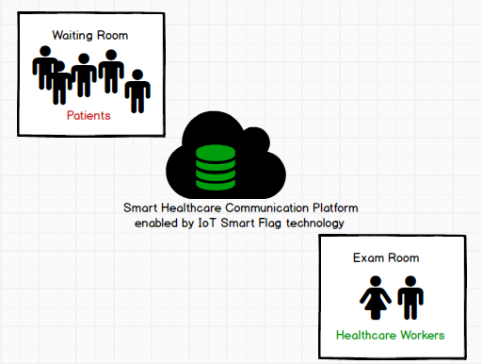

Smart healthcare IoT Flags
Match Patients with the right Healthcare at the right time
Knowing the room status is essential
Recommend Video Triage or Video Care via services such as Doctor on Demand during peak times
Use chatbots to get patients to the right healthcare worker for their situation (ER/Doctor/UrgentCare/PA)

Slide 4
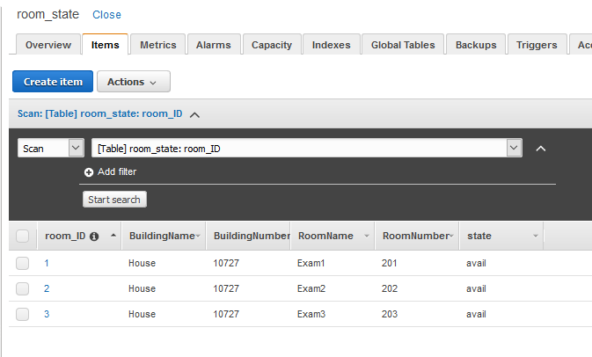
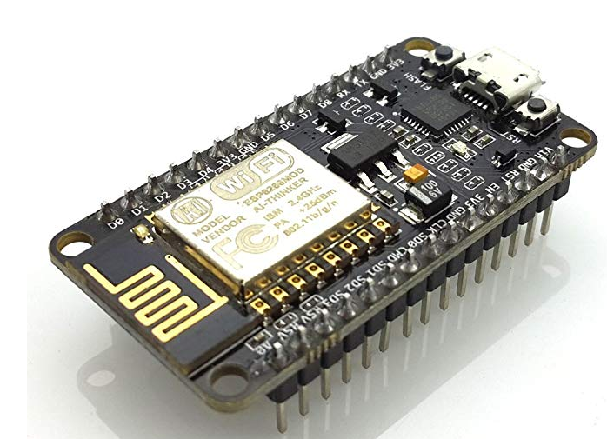


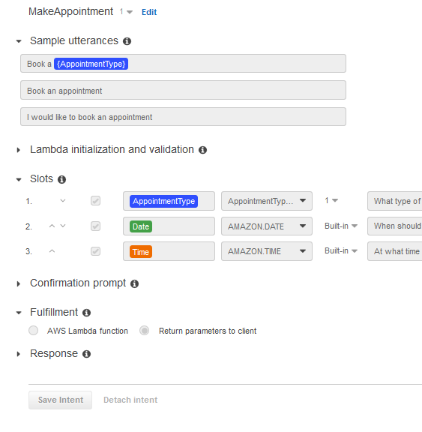

Technology requried
Room(Flag) State Database (AWS DynamoDB)
Patient State Database (AWS DynamoDB)
Lex Chatbots
SMS/FAX API for communication workflows (I couldn’t get into developer tools so I tested with Webtext API and AWS SNS)
NodeRed for the event driven data and dashboarding
ESP8266 IoT board or similar microcontroller board with wireless technology

Slide 5
Goals of product
Patient Experience
Patient Gets improved customer experience through better communication
Mobile Alerts or SMS messages enable patient to get better estimated wait time (similar to restaurant waiting line paging technologies)
If there is a long wait at patient can reschedule to a more convenient time using a chatbot
Healthcare Provider Experience
Hospital administrators can reduce costs by staffing to the peaks better
Triage could be automated via chatbot questionnaires via SMS or Chat
Faxes and customer documents could be sent via secure chat and appended to medical record
Doctors could get “screnpop” data with key details about a patient right before entering Exam room to give customers a better experience and begin narrowing down a diagnosis based upon additional data

Slide 6
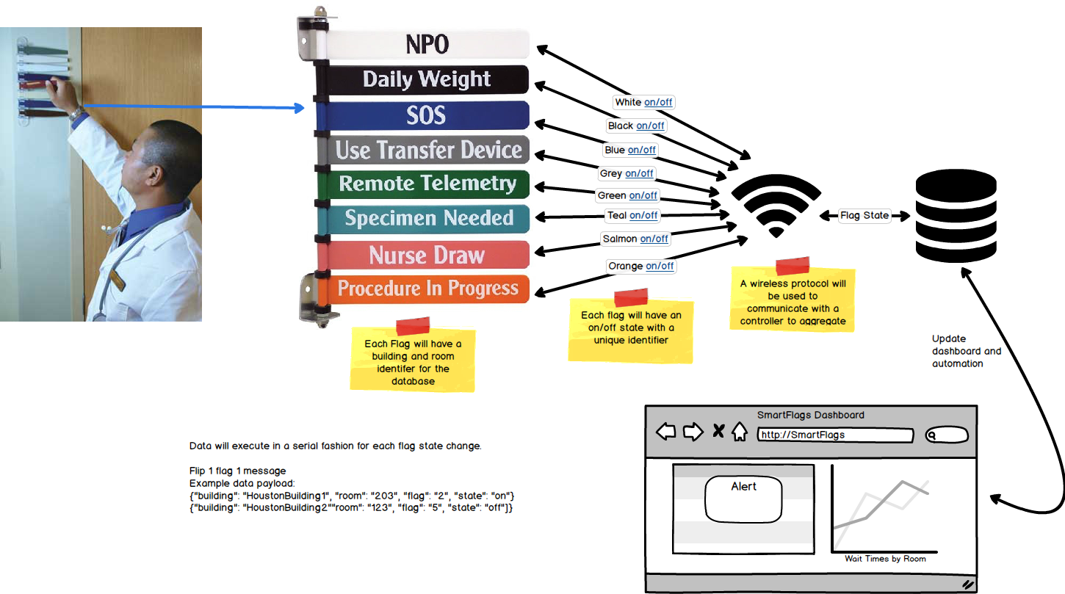
Smart IoT Room Flags Features
Create Smart Flags to identify patient exam room availability and match that to patients
Create room status that can be reported on in real-time and trended over time
Apply Workforce management technologies to better staff to demands
Give patient more input on wait times such as patient ahead of you in line
Allow patient to reschedule via chatbot
Present Medical workers with “screen pop” of data passed via secured Chatbots

Slide 7
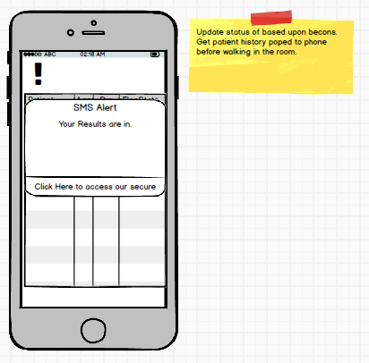
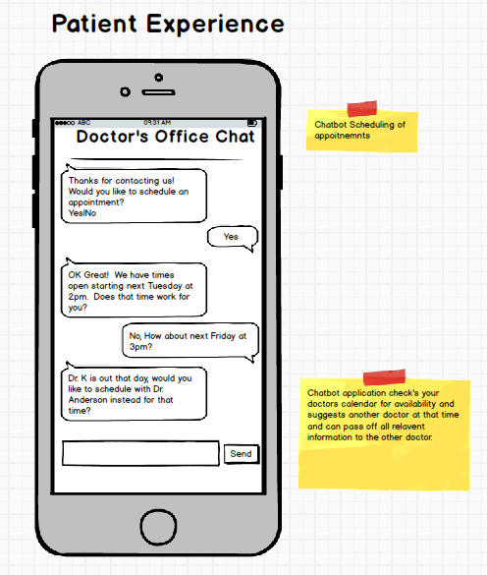
Patient Experience
Chatbot enablement of Appointments
Give patient information in realtime

Slide 8
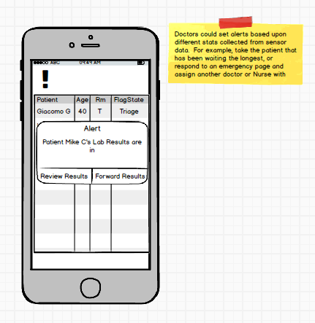
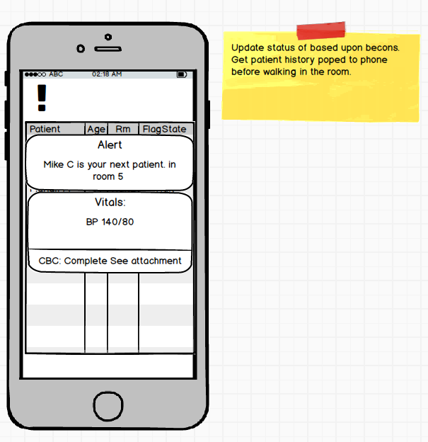
Healthcare Experience
Send doctor notifications of patient labs via alerts so that they have context before walking into a patient exam room
Alert hospital Triage when a customer waits are high and give customer the option to reschedule or send the customer for lab work while they based upon doctor recommendation
Healthcare workers can continue to use flags as a visual indicator on room status, but the flags will be equipped with sensors to report room state

Slide 9
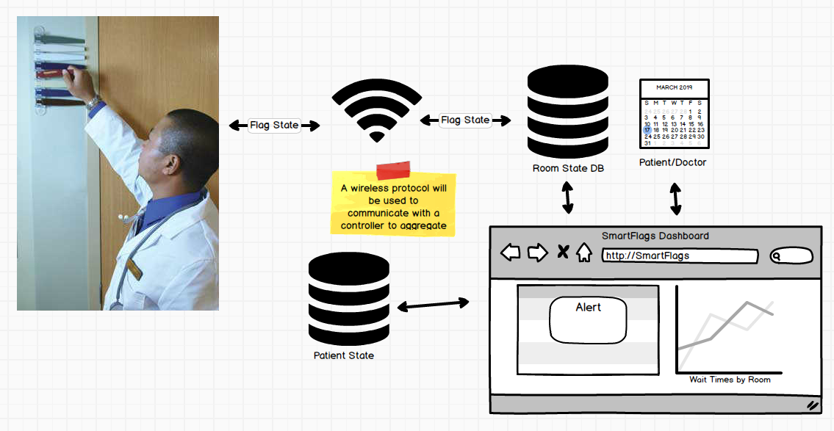
The flow of IoT data
Doctor/Nurse flips flags outside of room as normal
Sensors and a ESP8266 microcontroller send updates back to a gateway
Application Rules Engine determines what each flag state is and what room it represents
Real-time Patient State and Exam Room State are updated in real-time
Rules engine NodeRed can trigger workflows and/or chatbots
Chatbot interacts with either patient or medical staff based upon predetermined rules

Slide 10
Summary
I wasn’t able to complete my hack in the 2 days allocated, but I was able to build several design documents and begin prototyping each of the technologies that I would use to implement this as a real product.
With more time I will complete this design and implement it as a cloud-based design with help from a few IoT microcontrollers and/or gateways.

Slide 11
Thank you!

